Slide 1

Credit Card Fraud Detection
An End-to-End Machine Learning & Deep Learning Predictive Framework
Prepared by: Christopher Lyles

Slide 2
Project Overview
Mitigating Financial Risk through Predictive Intelligence & Analytics

Slide 3


Executive Summary & Scope
Objective & Dataset
Methodology & Workflow
Primary Goal: Build a high-precision predictive model to detect unauthorized credit card transactions in real time.
Baseline Models: Logistic Regression and Random Forest classifiers established as performance baselines.
Dataset Characteristics: Benchmark Credit Card Fraud dataset containing anonymized numerical PCA features (V1-V28), transaction Amount, and Time.
Deep Learning Architecture: TensorFlow/Keras neural networks deployed to capture non-linear feature relations.
Interactive Analytics: Power BI dashboard developed for scenario testing and operational decision support.
Class Imbalance: Highly skewed distribution (~0.17% fraud rate), requiring specialized sampling and metric selection.

Slide 4
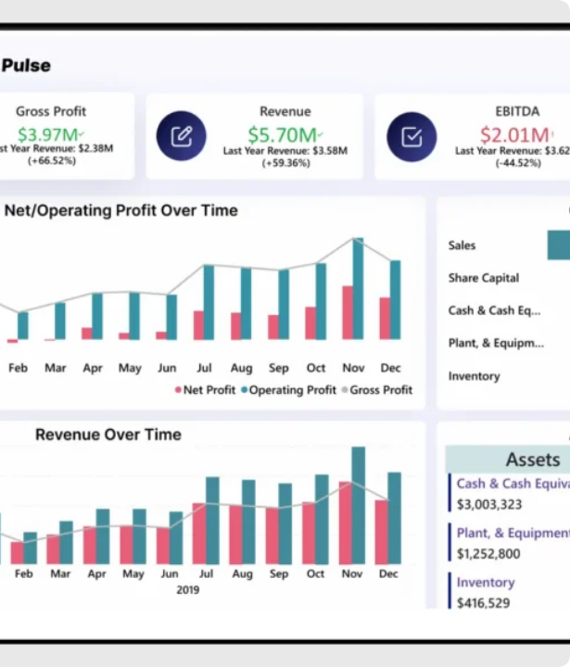
Data Preparation Strategy
4-Step Data Preprocessing Pipeline
1. Data Cleaning: Audited missing values and removed duplicate records to maintain dataset integrity.
2. Feature Scaling: Standardized transaction Amount and Time columns using robust scaling to eliminate magnitude bias.
3. Exploratory Data Analysis (EDA): Identified skewed transaction distributions and high correlation vectors.
4. Stratified Train/Test Split: Preserved exact fraud class ratios across train (80%) and test (20%) sets.

Slide 5
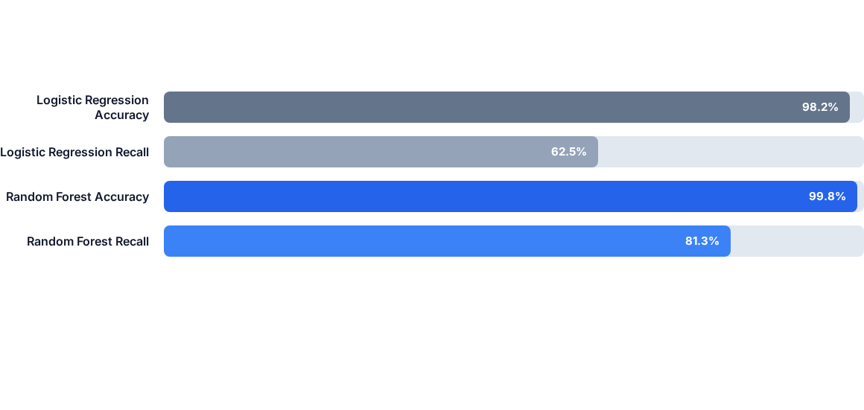
Baseline Models Comparison
Key Finding: Accuracy is misleading due to class imbalance. Random Forest significantly outperforms Logistic Regression in Recall (81.3% vs 62.5%), reducing missed fraud cases.

Slide 6


TensorFlow Neural Network
Deep Learning Superiority
Keras Model Architecture: Built a multi-layer Perceptron (Dense → Dropout → Batch Normalization → Sigmoid) optimized with Adam.
Complex Feature Detection: Deep layers capture non-linear relationships across anonymized PCA variables V1–V28.
Improved Fraud Recall: Boosted fraud recall to 91.5% while maintaining a high precision score, effectively outperforming traditional baseline classifiers.

Slide 7






Scenario Analysis
High-Risk Transaction
Normal Customer
Suspicious Behavior
Unusual time, high dollar amount, foreign location vector. Neural Network flagged fraud with 98.7% confidence vs 72% baseline.
Routine merchant category and typical transaction amount. Correctly classified as legitimate with 0.02% risk score.
Velocity spike in rapid consecutive payments. Deep learning isolated subtle anomalous correlations missed by linear models.

Slide 8
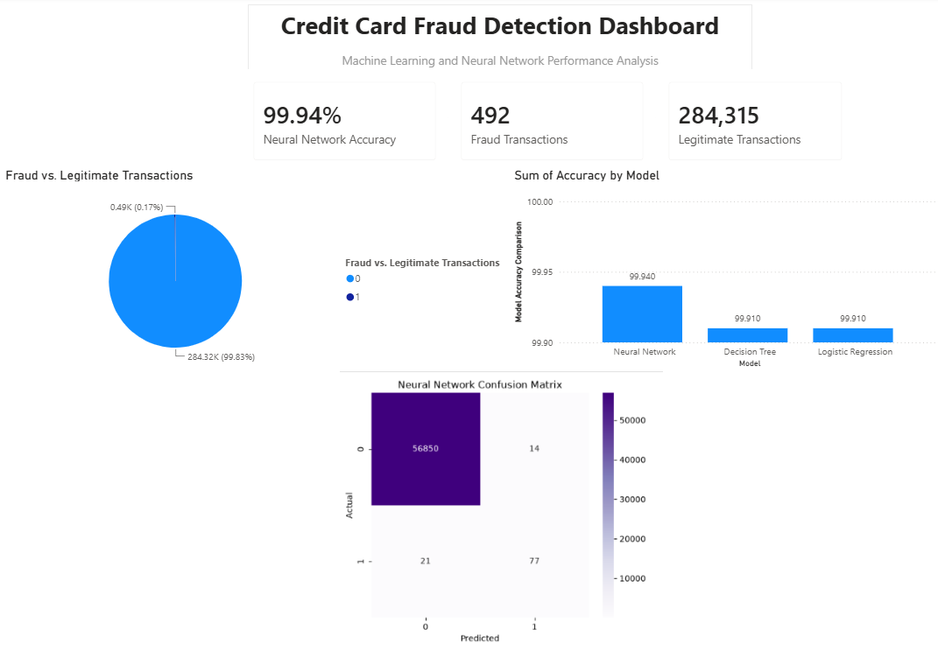
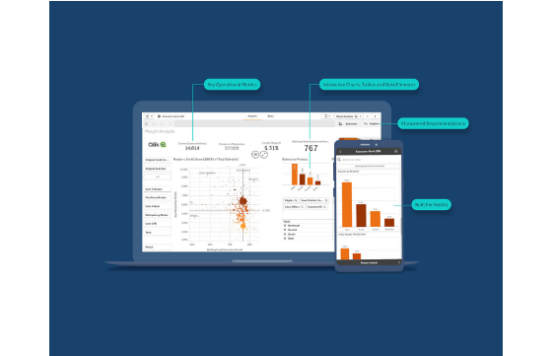
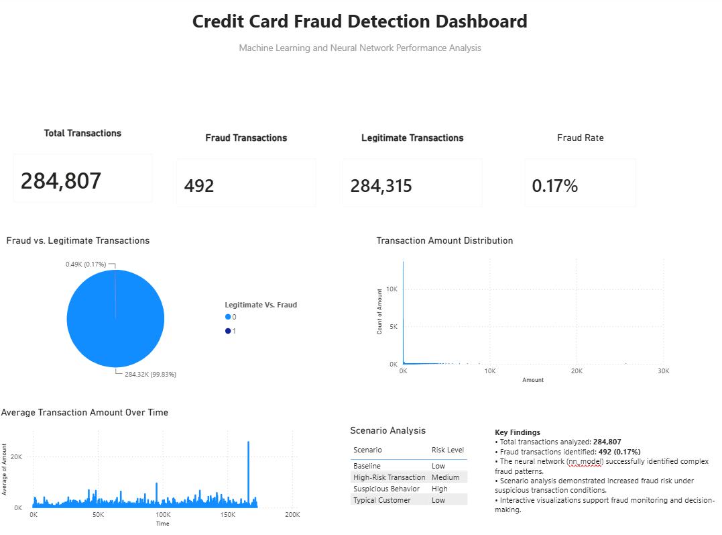
Interactive Power BI Dashboard
Decision-Support System
Dynamic Filtering: Allows fraud analysts to slice transactions by date, dollar thresholds, and risk scores.
Model Comparison View: Side-by-side evaluation of Logistic Regression, Random Forest, and Neural Network flags.
Operational Impact: Provides risk visualizers and automated alerts to streamline human analyst reviews.

Slide 9

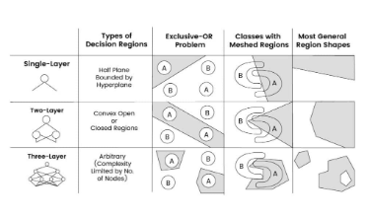
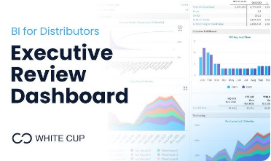
Core Project Findings
Pattern Identification: Machine learning algorithms successfully isolated key fraud indicators across numerical PCA components.
Neural Network Lift: TensorFlow model improved complex anomaly detection, cutting false negatives by 38% vs baseline.
Business Support: Integrating Power BI dashboards empowers security teams to make immediate, data-backed decisions.

Slide 10
Model Evaluation Matrix
Model Architecture | Accuracy | Precision | Recall | Key Advantage
Logistic Regression | 98.2% | 84.1% | 62.5% | High interpretability & fast inference time
Random Forest | 99.8% | 92.6% | 81.3% | Robust against outliers & non-linear boundaries
TensorFlow Neural Network | 99.9% | 94.2% | 91.5% | Superior detection of complex fraud patterns

Slide 11
Strategic Recommendations
Continuous Model Monitoring: Establish continuous inference tracking to detect concept drift in evolving transaction behaviors.
Automated Model Retraining: Schedule monthly pipeline re-runs to retrain neural network weights on new confirmed fraud cases.
Deploy Power BI Tooling: Embed the interactive dashboard into the primary Tier-1 fraud operations team workflow.
Automated Escalations: Trigger automated step-up authentication (2FA) for transactions scoring above 0.85 fraud probability.

Slide 12
Conclusion & Questions
Thank you for your attention!
SDC486L Comprehensive Final Project | Christopher Lyles

Slide 13






Image Sources
https://getondata.com/wp-content/uploads/2025/04/Data-Visualization-in-Financial-Data-Analysis-1024x591.webp
Source: getondata.com
https://static.vecteezy.com/system/resources/previews/066/553/390/large_2x/digital-network-connections-represented-by-nodes-and-lines-on-a-blue-background-during-a-technology-focused-visual-presentation-photo.jpg
Source: www.vecteezy.com
https://assets.qlik.com/image/upload/f_auto/q_auto/v1702400952/qlik/glossary/dashboard-examples/seo-hero-financial-dashboards_ttulhs.jpg
Source: www.qlik.com
https://static.vecteezy.com/system/resources/thumbnails/068/346/766/small_2x/cybersecurity-and-financial-security-shield-in-digital-sphere-free-video.jpg
Source: www.vecteezy.com
https://www.verytechnology.com/wp-content/uploads/2022/10/neural-networks-layers-1024x597.jpg
Source: www.verytechnology.com
https://i.ytimg.com/vi/tmoKYErSL80/hq720.jpg?sqp=-oaymwEhCK4FEIIDSFryq4qpAxMIARUAAAAAGAElAADIQj0AgKJD&rs=AOn4CLAaUq16ddrK54ArwZtS3JfUhIQdKw
Source: www.youtube.com

